Slide 1


Department of Information Technology ABES Engineering College, Ghaziabad, UP
Mini Project / Industrial Training Presentation SESSION 2023-24 BCC-351
TITLE : Coffee Shop
Name-Agrim Gupta
Branch & Section: IT-A
Roll No. – 2300320130022
Admission No. - 23B0131118

Slide 2

Coffee Shop Website: An HTML and CSS Journey
Welcome to our presentation exploring the creation of a captivating coffee shop website using the power of HTML and CSS. Join us as
we search into the design process, key features, and responsive development techniques that bring this digital haven to life.

Slide 3
Introduction to the Coffee Shop
The Vision
Target Audience
We envision a website that reflects the coffee’s color background of our coffee shop’s website. It should attract customers with a captivating visual experience and provide easy access to essential information.
Our target audience includes coffee lovers, and anyone seeking a relaxing and inviting space to enjoy their favorite brew. We aim to cater to a diverse customers with varied tastes and preferences.

Slide 4

Design Considerations and Branding
Brand Identity
We'll develop a unique brand identity that reflects the coffee shop's character. This includes logo design, color palette and overall aesthetic.
User Experience
We'll prioritize a user-friendly interface that is understood and easy to navigate, ensuring a seamless and enjoyable experience for visitors.

Slide 5





Building the Homepage
Hero Section
Menu Showcase
Pricing
A captivating hero section will greet visitors with a facinating image, a concise tagline, and a clear call-to-action.
A leading menu section will showcase the coffee shop's signature coffee, pastries, and other offerings, with high-quality imagery.
Clear information about the coffee shop and readily available, including rates in INR.

Slide 6
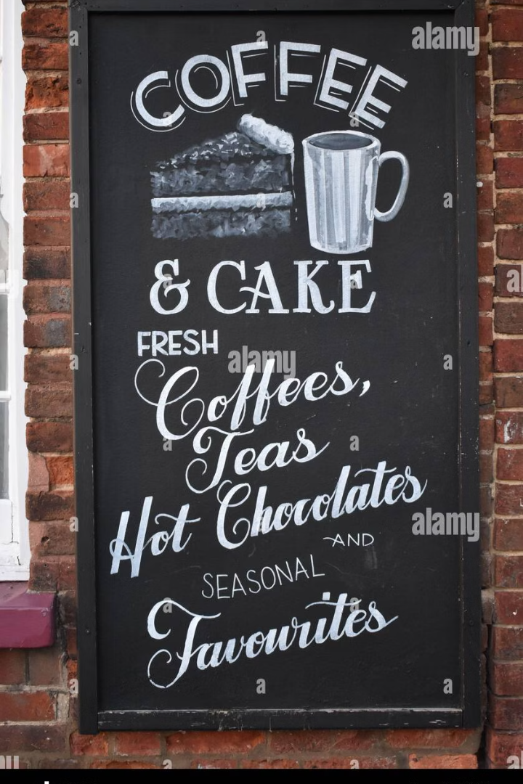


Crafting the Menu Page
Interactive Menu
An interactive menu will allow users to easily browse the various coffee beverages, teas, pastries, and other items.
Visual Appeal
High-quality images of each menu item will enhance the visual appeal and stimulate customer desire.

Slide 7
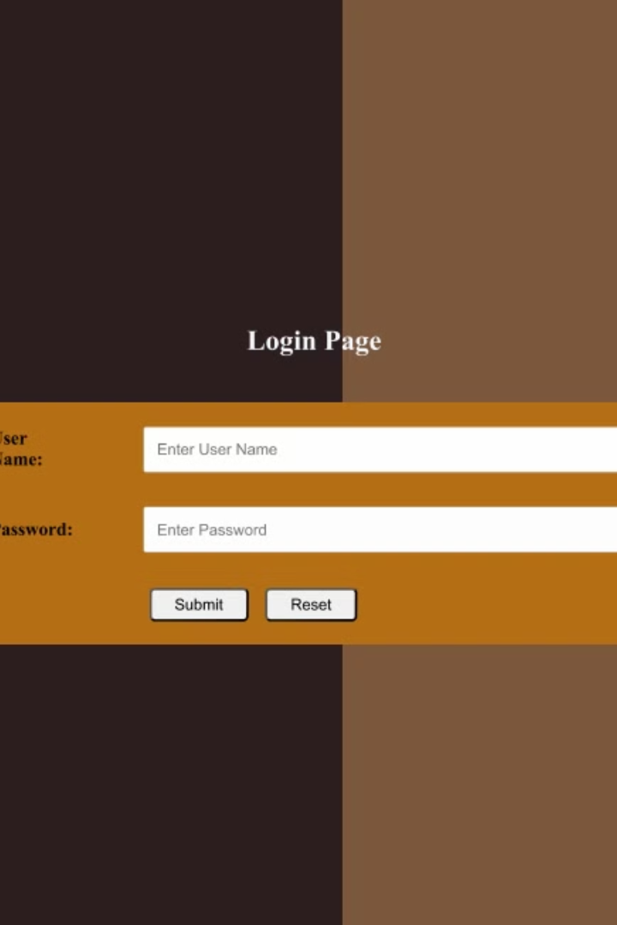
Integrating the Contact Form and Login Page
1
2
Contact Form
Login Page
A user-friendly contact form will enable visitors to easily reach out to the coffee shop with inquiries or feedback.
A secure login page will allow registered users to access exclusive content or loyalty programs.

Slide 8


Conclusion and Future Work
Key Takeaways
A well-designed coffee shop website is essential for attracting customers, promoting brand awareness, and providing a positive user experience.
1
Next Steps
We'll continue to refine the website by incorporating user feedback, adding new features, and ensuring its continued consistency with emerging technologies.
2

Slide 9
So, let’s move to the final view of project :-

Slide 10
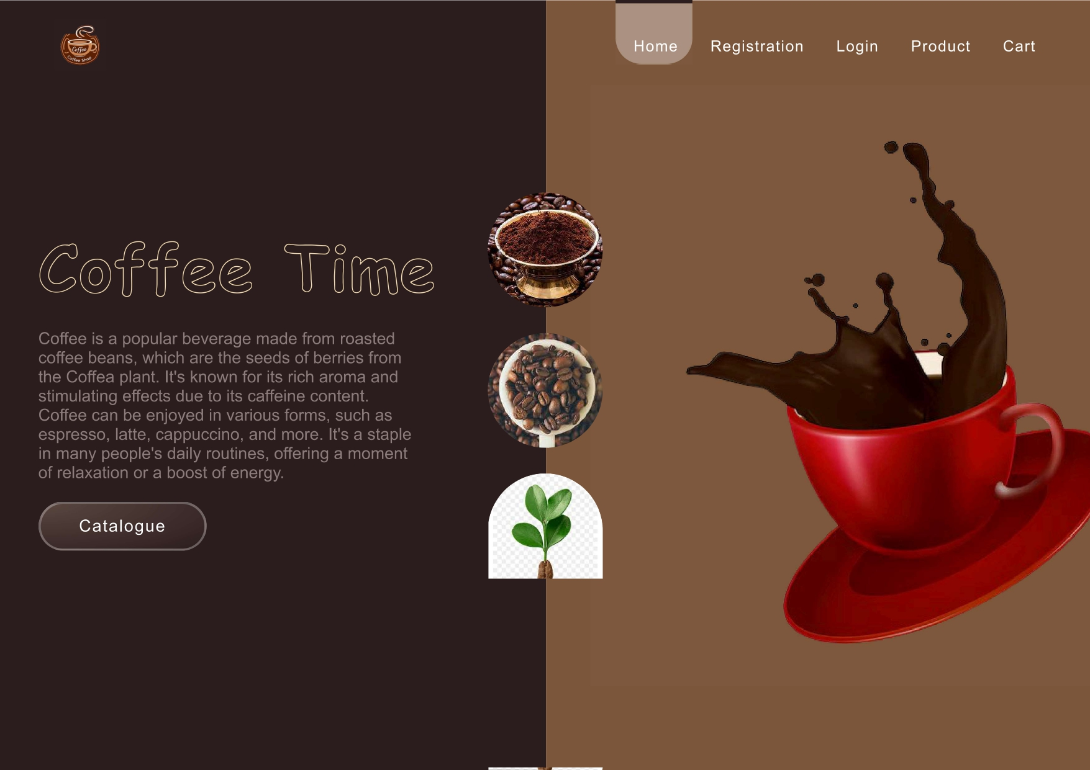

Slide 11
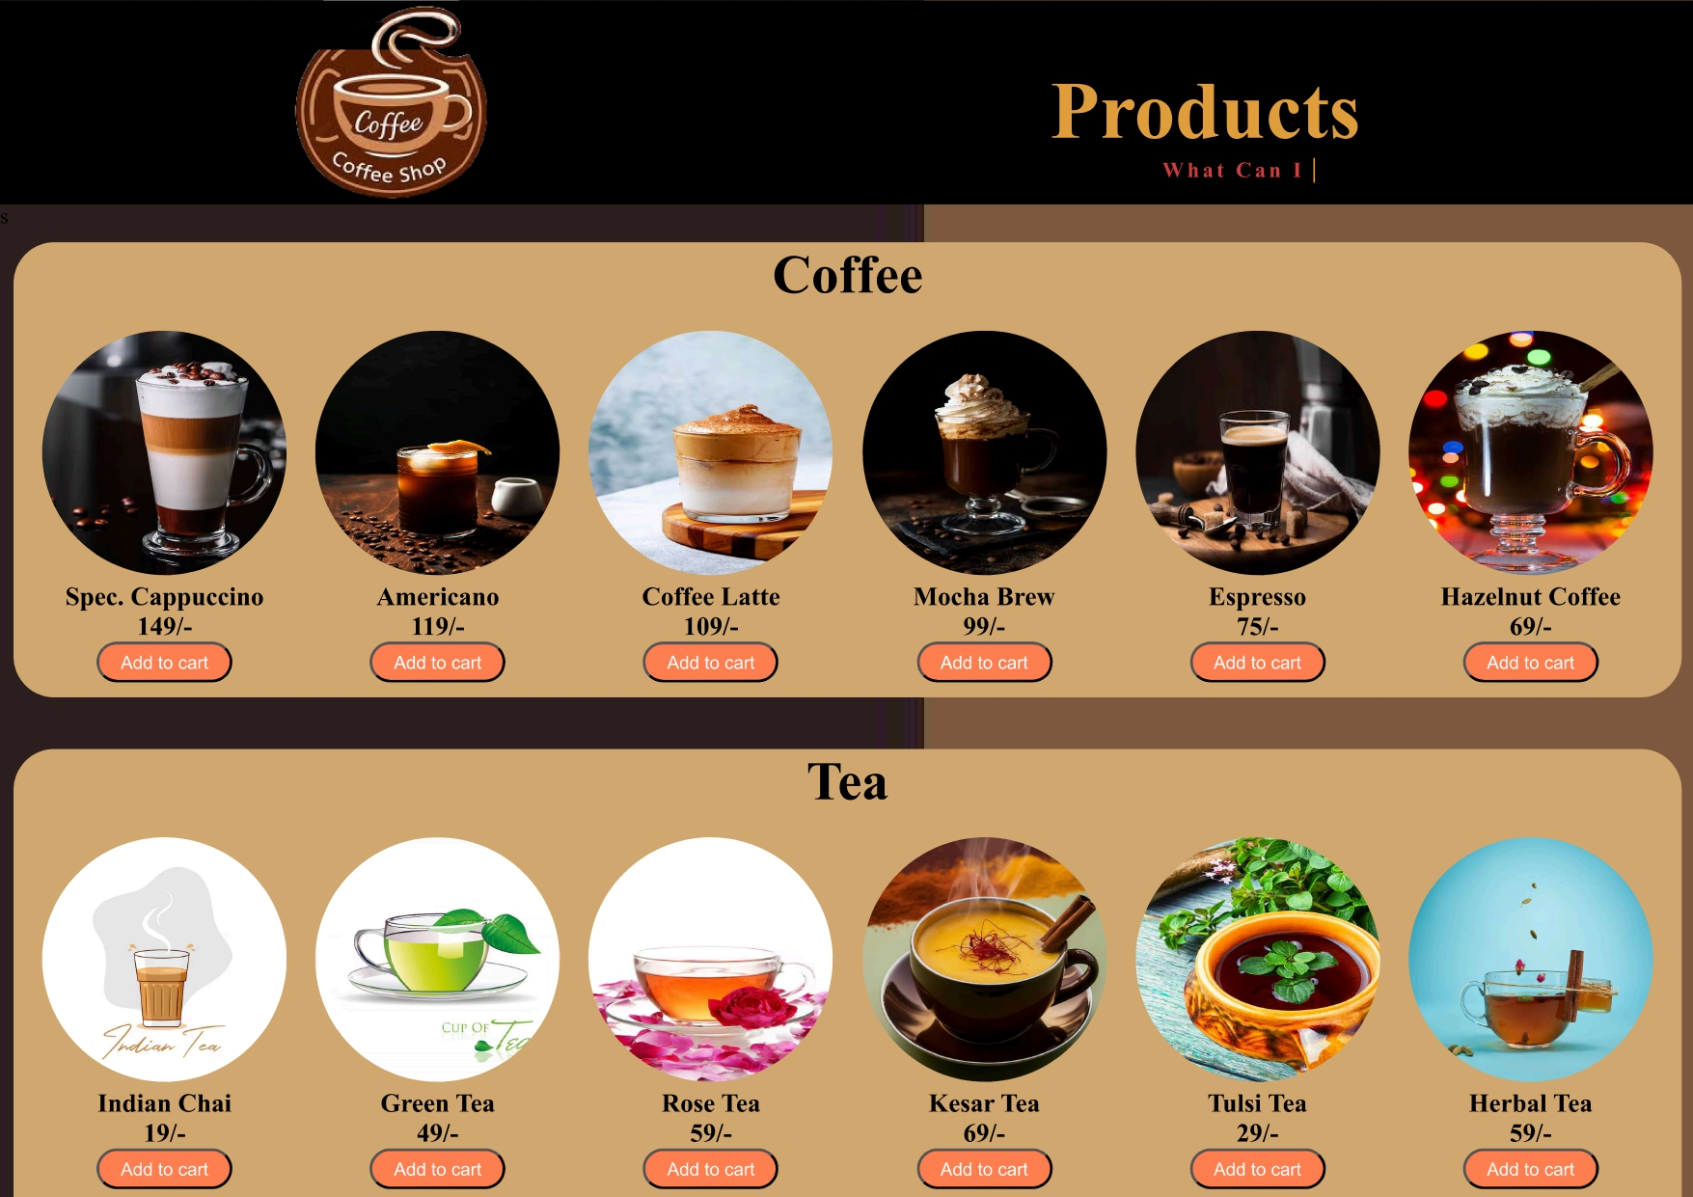

Slide 12
Thank you…!
~AGRIM GUPTA

